Slide 1

Sensor Kit (Kit 1)
ZAS Robotics Training

Slide 2



Sensor Kit - Contents
Sensor Kit Components
Sensor Creative Board

Slide 3



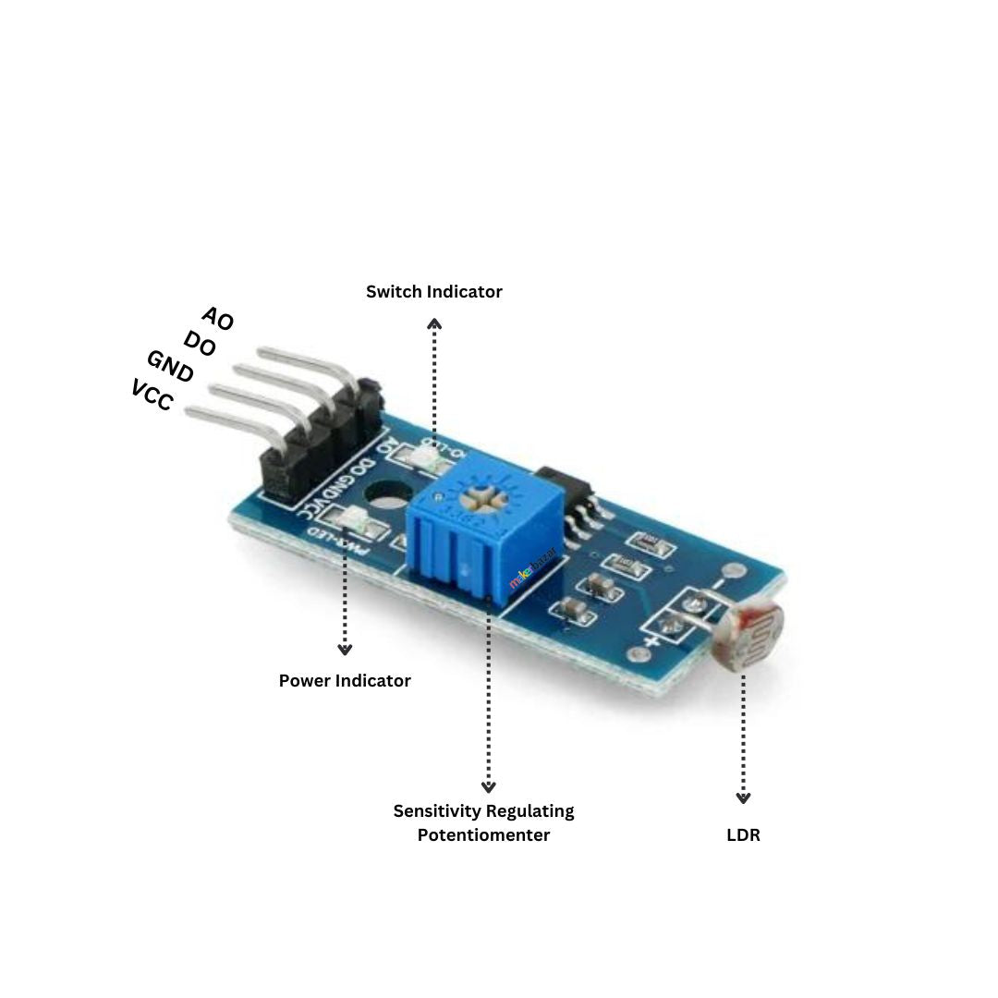

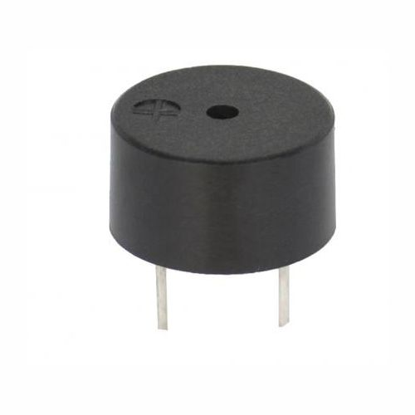
SFL08: LDR SENSOR WITH BUZZER and LED
Things Needed

Slide 4
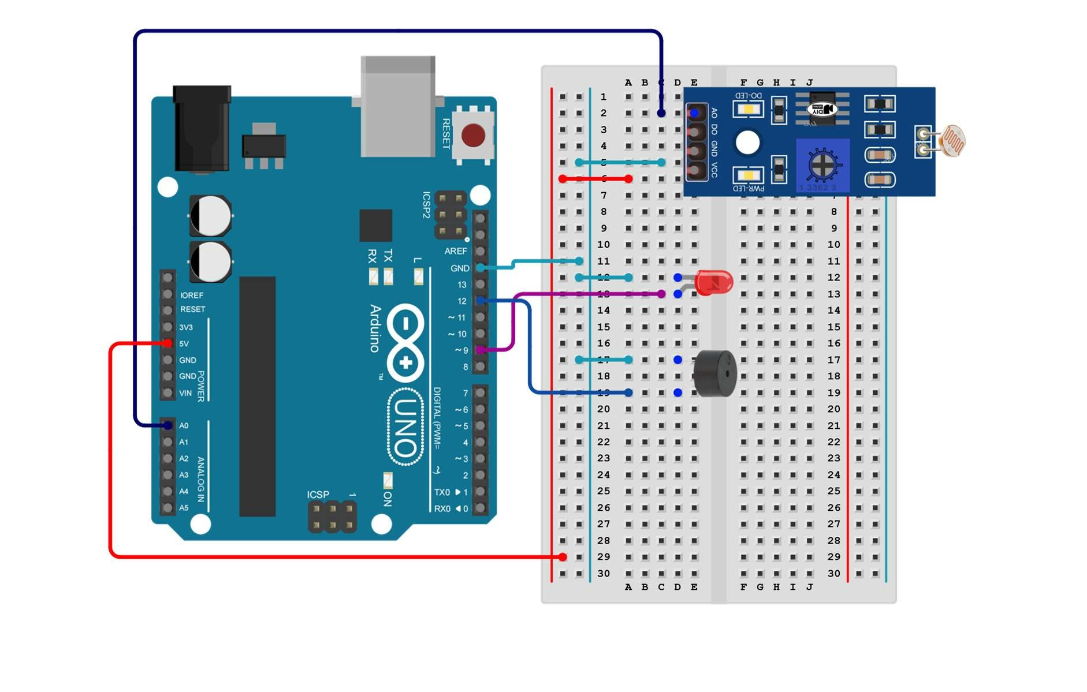
SFL08: LDR SENSOR WITH BUZZER and LED
Connections:
Arduino Pin | breadboard
GND(short end) | Blue line
Anode(long end) | Purple line
GND | Light blue
Pin 12 | Dark blue
GND | Light blue
5V | VCC(red)
A0 | Analogue output(violet)
LED
buzzer
LDR

Slide 5
SFL08: LDR SENSOR WITH BUZZER and LED
Include library and define module pins
Setup()
LDR(5v-vcc;GND;AO-A0 pin)
LED(GND,Pin9)
Buzzer( GND, pin 12)
Loop()
if light level decreases to a certain threshold LED and buzzer get activated, and vice versa
Code for Lesson SFL08:
https://github.com/info-zas/zas-robotics-sensors/blob/main/01_FoundationProjects/01_Code/_08_UsingLDRtoDetectLightAndTriggerAlerts/_08_UsingLDRtoDetectLightAndTriggerAlerts.ino

Slide 6
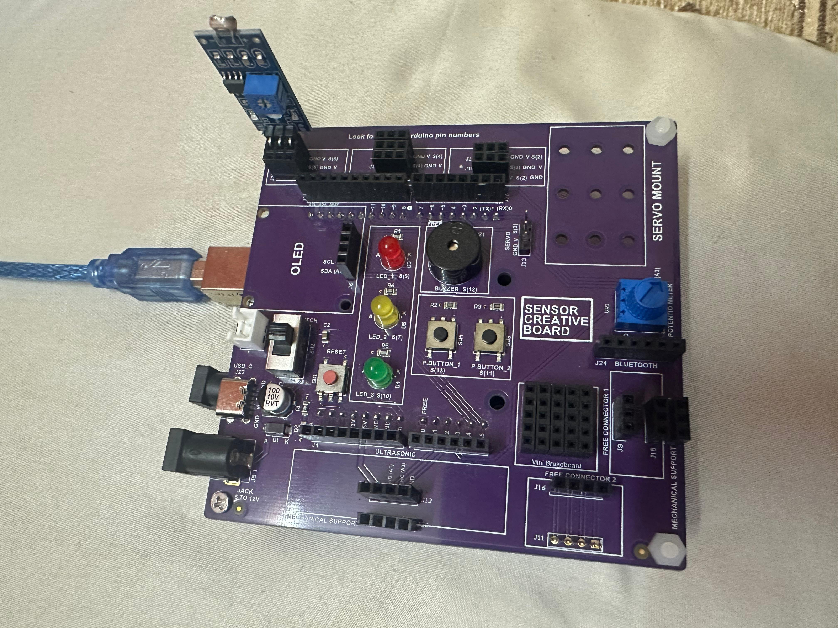
SFL08: LDR SENSOR WITH BUZZER and LED

